Slide 1

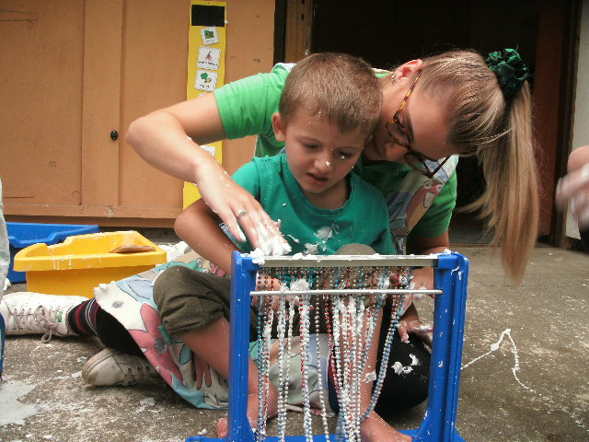
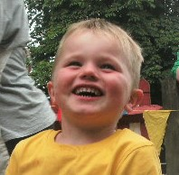
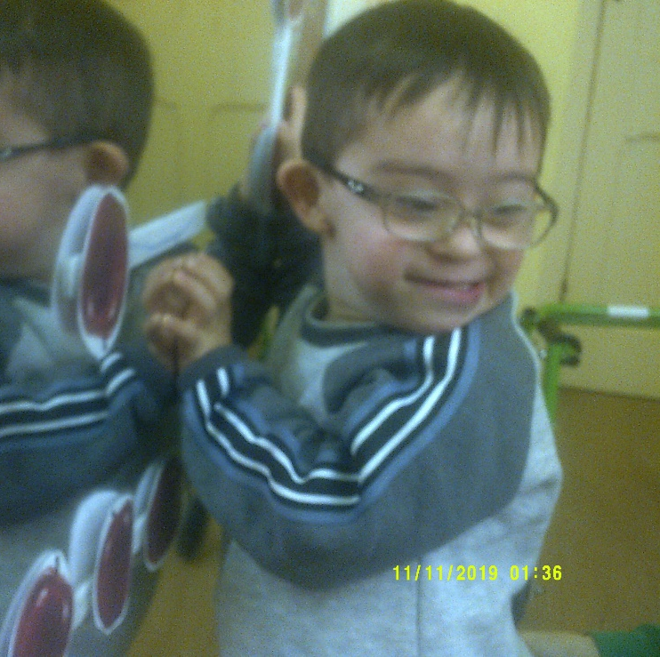
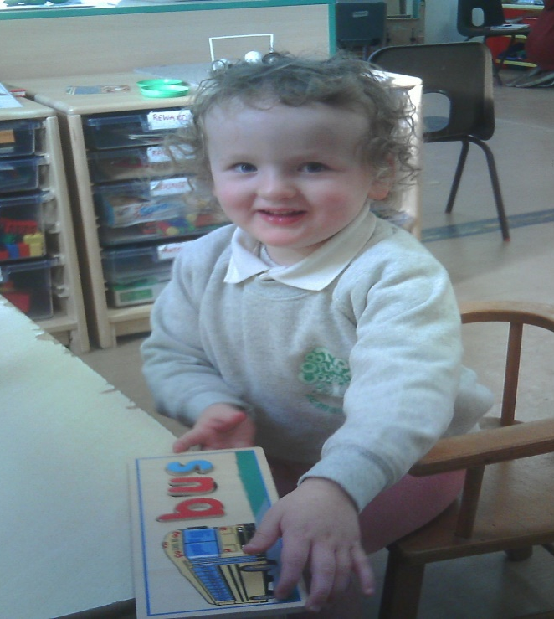


Slide 2
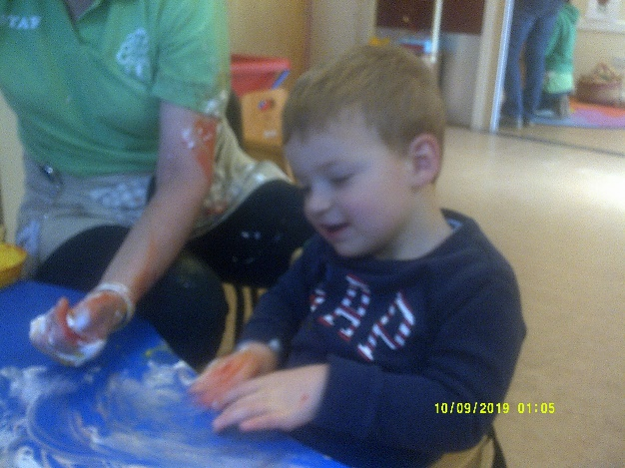
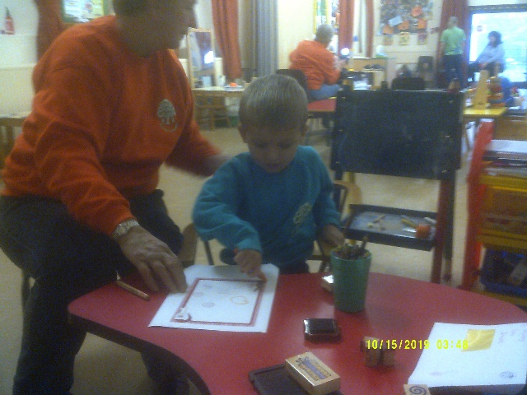
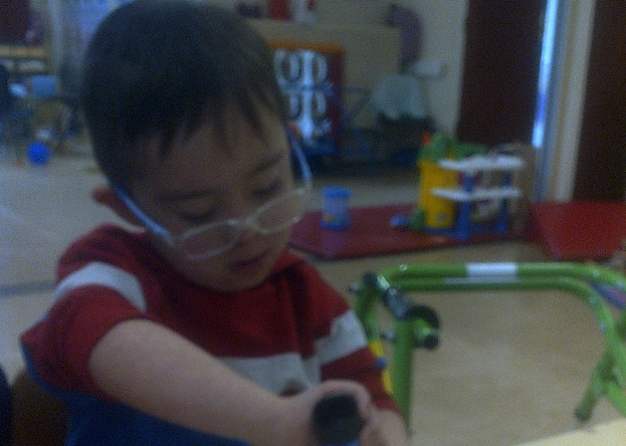
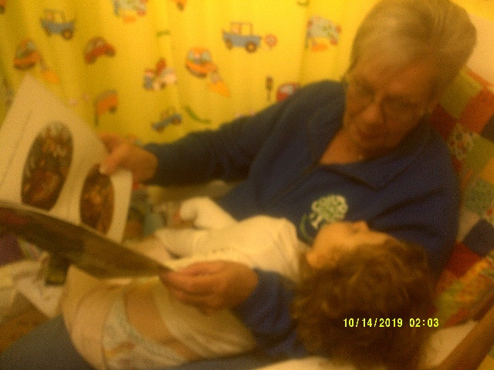
Who are we?
Cobtree Playschool is a registered provider of Nursery education, situated in the lovely grounds of Mote park. We have been supported by Maidstone Mencap Charitable Trust for over 30 years, becoming an integral part of our local community.
Maidstone Mencap is a local charity supporting young adults and children who have learning difficulties, additional needs or disabilities.
All the children entrusted into our care will have a special educational need and /or a physical disability, have medical needs, many will be autistic impacting of there social communications, interactions functional communications and sensory regulating behaviours. difficulties in their communications.
Our vision is to make a positive difference by enabling and empowering all children and young people in our care to achieve their full potential.
Our mission is to provide the best possible start for them through our care, education and therapy support from their early years onwards; all within our safe and caring environment.
As a charity we are affiliated to national Mencap but rely on local volunteers and our local community fundraising to support the running of all our provisions.

Slide 3
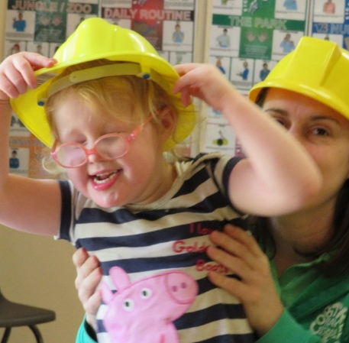

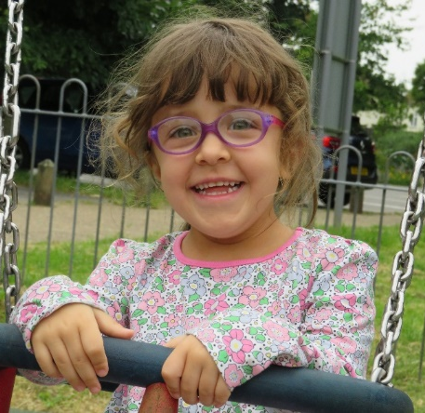
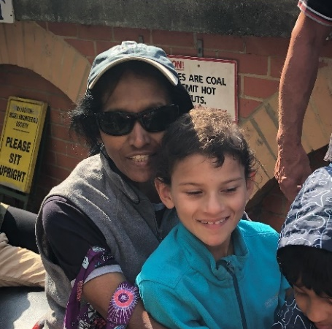
What we do?
Cobtree Playschool for Special Children
A registered provider of nursery education for children from the age of 9 months to 5 years
Junior Gateway – A Saturday club for 5 – 16 year olds.
Holiday Club – a summer club for those aged 5-18 yrs
Youth Club – A club for 16-18 + year olds.
- Also in the Hall at Maidstone Mencap…
Senior Gateway – A weekly club for adults.
.

Slide 4
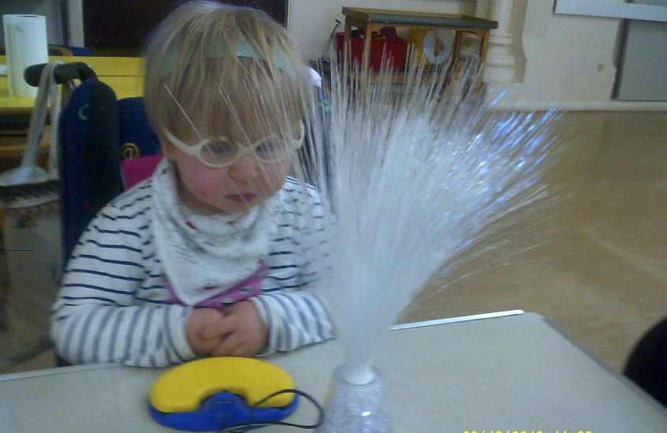
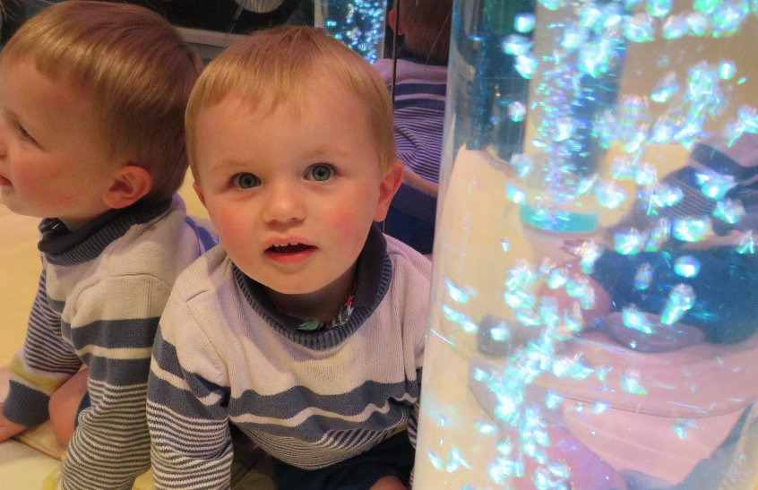
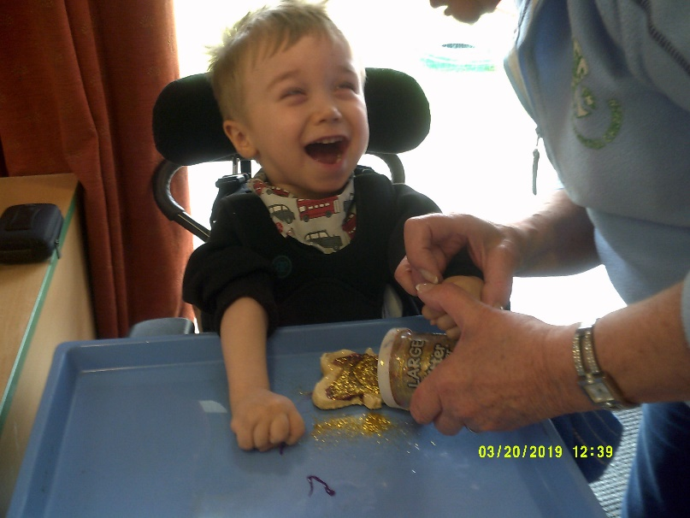
Cobtree Playschool for Special Children
Service statement
As a registered provider of Nursery Education, here at Cobtree Playschool, we strive to provide the highest quality of care and education for all our children, ensuring they are happy, safe and secure within our environment.
We aim to assist all children attending our playschool to attain their maximum potential, by providing experiences where learning is based through a combination of their own play, their interests and our structured carefully planned activities.
We are able to meet each child’s own level of learning and development, with the continuing cycle of monitoring, observations, reflections and assessments supporting their individual and personalised planning; recognising that children are the best at being who they are.
Our aim is to continually provide a warm safe and happy environment so the children can grow in confidence and learn through their play, therapy and specialist teaching.

Slide 5
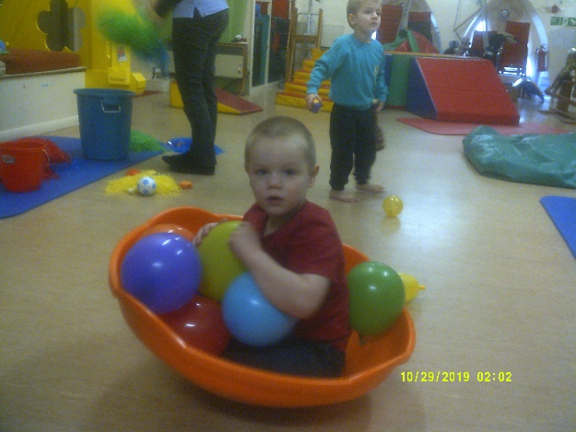
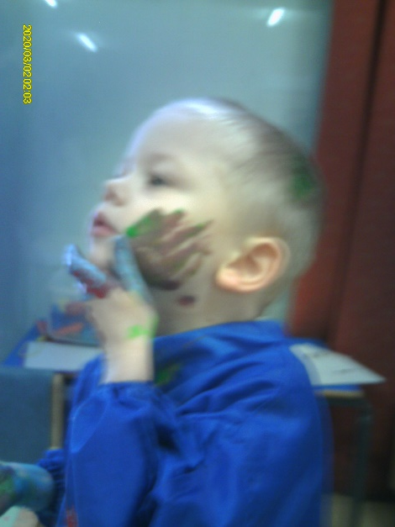
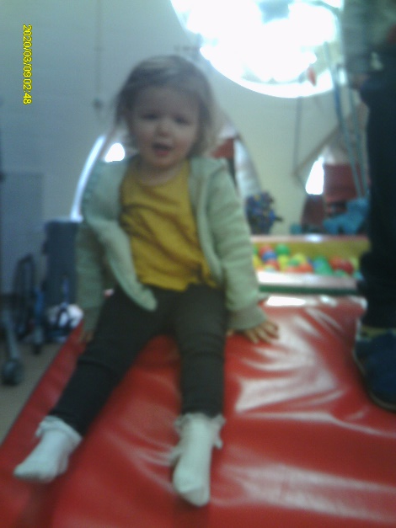
Our support
Our Policy is to work closely with parents and carers, we will support your needs in giving you the peace of mind, that your child is receiving the highest quality of care from us.
We work closely with each Childs' therapy support network, to reinforce their recommendations , strategies and techniques for their individual targets steps towards desired outcomes.
Each child has a personalised plan and a photographic journey to share with parents. We celebrate their achievements and unique progress together, with parent contributions and suggestions welcome and valued.
With have our website www.maidstonemencp.org and encourage families to join our Facebook family, our parents and our whats app group to share information and celebrate our achievements.

Slide 6
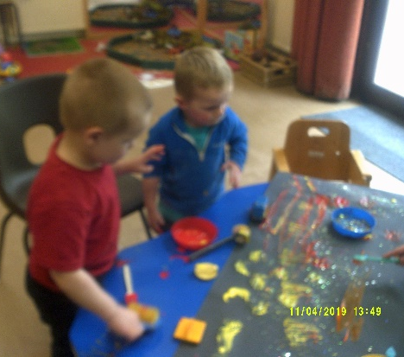
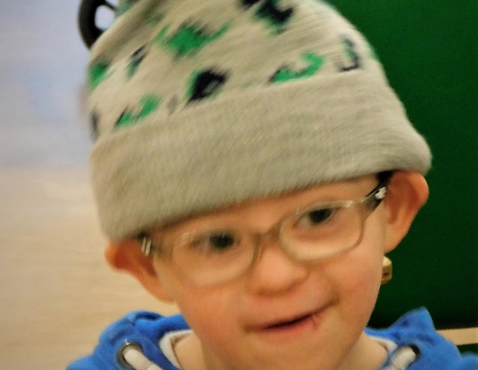
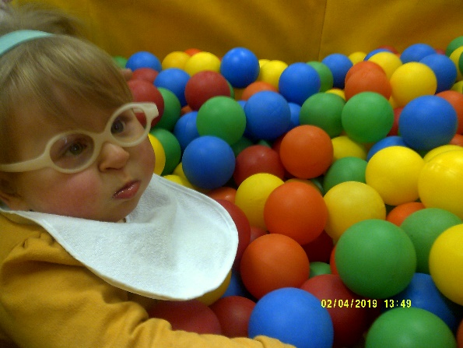
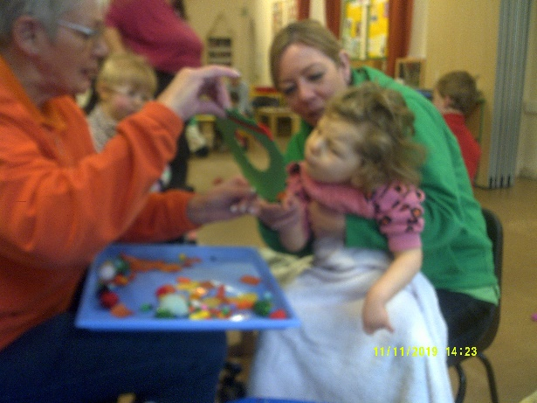
Introduction to Cobtree Playschool
Here at Cobtree Playschool we can offer a service that can meet the needs of parents and carers with children between the ages of 18months and 5 years, who have learning difficulties additional needs or disabilities.
We currently run three sessions Monday, Tuesday and Wednesday Thursday 10-1 during term times only.
At Cobtree Hall we have the facilities that will enable us to provide a large range of specialist equipment, teaching resources, toys and communication aids for the children. In our hall, we have two large floors, one with lots of physical play resources like the ball pit and soft play .shapes, the other downstairs, has access to our fenced in garden, with the learning environment set out with resources for play and developmental goals. Downstairs we also have a sensory room, including a bubble tube, lots of different lights, and music with cushioned cosy areas , for all the children to enjoy.
The children all receive support in small key groups, led by an experienced key person and supported by a dedicated team of volunteer carers ensuring the personalised care and teaching each child will have.
The children and their families will have the consistency in knowing, that a trusted and familiar person is accessible and available as a point of contact for them at all times. With this understanding, parents and their children can thrive knowing that they can have a special relationship, with constant care, encouragement, guidance and relevant learning opportunities throughout their time with us.

Slide 7
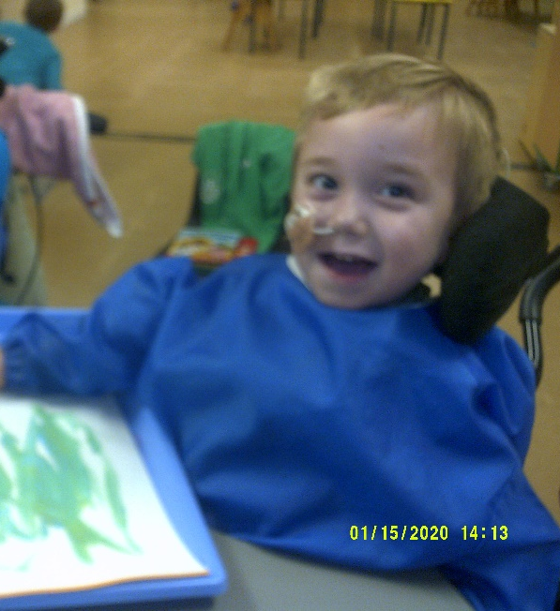
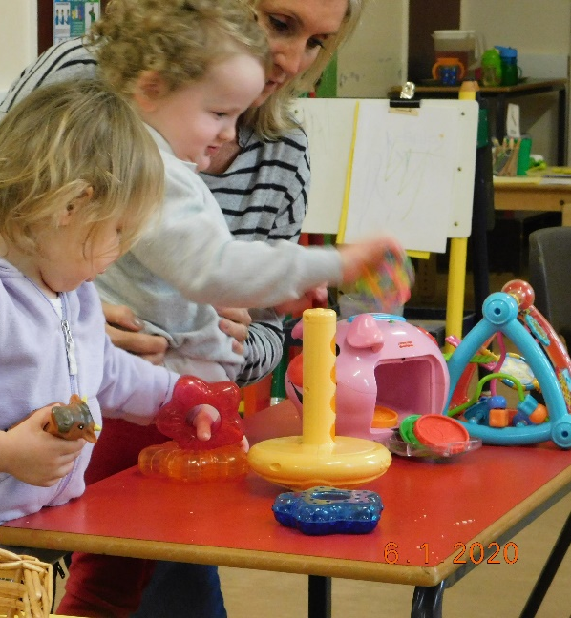
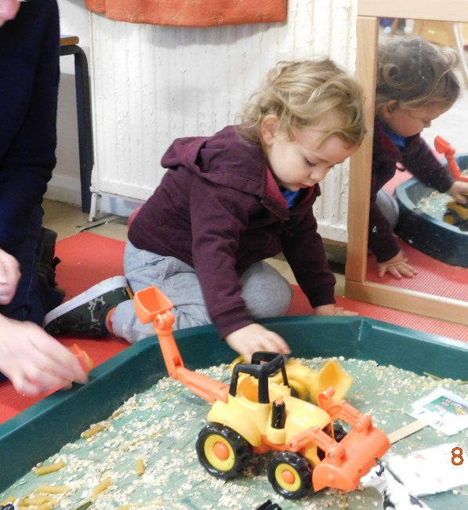
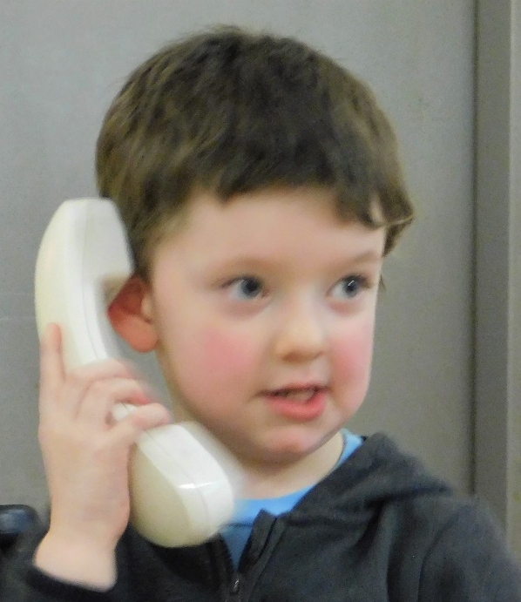
We are achieving through our fun and play

Slide 8
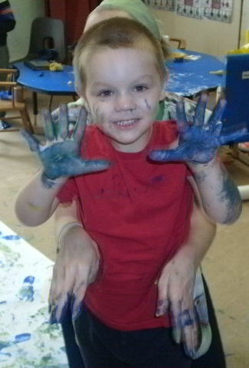
Connect with us
Liane Morris
manager@maidstonemencap.org
Cobtree Hall, Mote Park Willington Street, Maidstone ME15 8E
01622 670464
www.maidstonemencap.org
https://www.facebook.com/maidstonemencap
https://twitter.com/MaidstoneMencap

